Slide 1


Transform Tools with Applications
Transform Tools with Applications
carmine.clemente@strath.ac.uk

Slide 2
Introduction
In this block three discrete transforms will be introduced:
The Discrete Fourier Series Expansion (DFS)
The Z-Transform (ZT)
The Discrete Time Fourier Transform (DTFT)

Slide 3
Geometric Series

Slide 4
Geometric Series

Slide 5
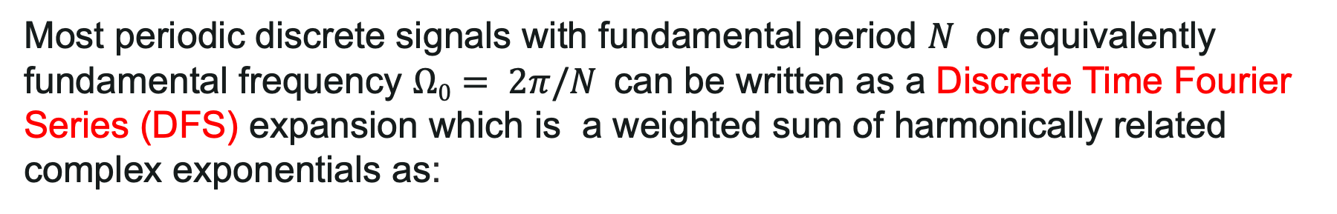
Discrete Fourier Series
Most periodic discrete signals with fundamental period $N$ or equivalently fundamental frequency $Ω0= 2π/N$can be written as a Discrete Time Fourier Series (DFS) expansion which is a weighted sum of harmonically related complex exponentials as:
DFS PAIR

Slide 6
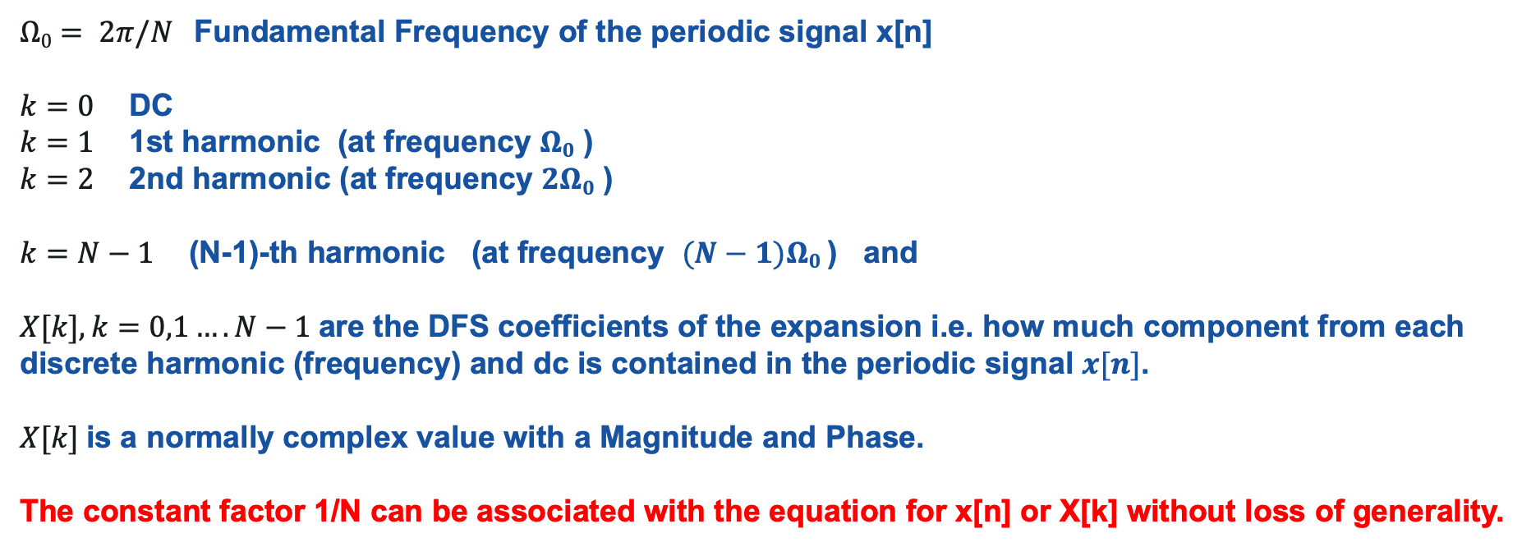
Discrete Fourier Series
$Ω0= 2π/N$Fundamental Frequency of the periodic signal x[n]
$k=0$DC
$k=1$1st harmonic (at frequency $Ω0$ )
$k=2$2nd harmonic (at frequency $2Ω0$ )
$k=N−1$ (N-1)-th harmonic (at frequency $(N−1)Ω0$) and
$X[k], k=0,1….N−1$are the DFS coefficients of the expansion i.e. how much component from each discrete harmonic (frequency) and dc is contained in the periodic signal $x[n]$.
$X[k]$is a normally complex value with a Magnitude and Phase.
The constant factor 1/N can be associated with the equation for x[n] or X[k] without loss of generality.

Slide 7
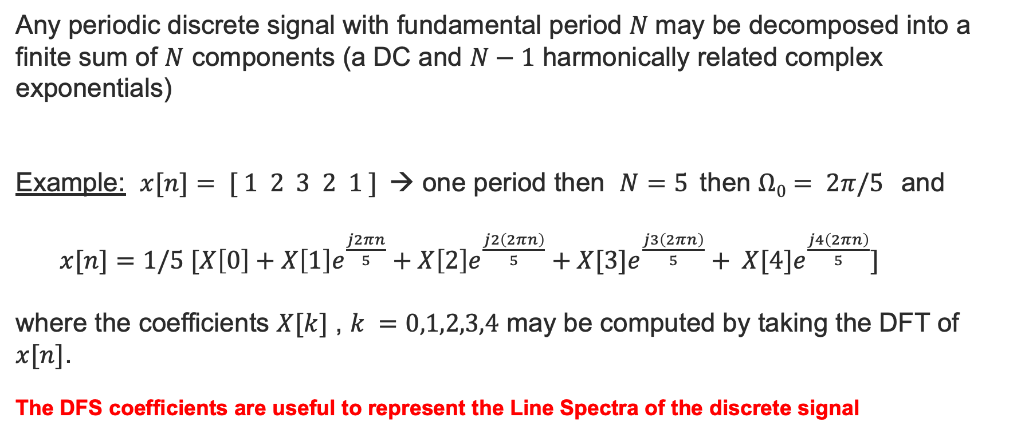
What does the DFS expansion Mean?
Any periodic discrete signal with fundamental period $N$may be decomposed into a finite sum of $N$ components (a DC and $N−1$ harmonically related complex exponentials)
Example: $x[n]= [ 1 2 3 2 1 ]$→ one period then $N=5$then $Ω0= 2π/5$and
$x[n]=1/5 [X\left[0\right]+X\left[1\right]e^{\frac{j2πn}{5}}+X\left[2\right]e^{\frac{j2\left(2πn\right)}{5}}+X[3]e^{\frac{j3\left(2πn\right)}{5}}+ X[4]e^{\frac{j4\left(2πn\right)}{5}}]$
where the coefficients $X[k]$ , $k =0,1,2,3,4$ may be computed by taking the DFT of $x[n]$.
The DFS coefficients are useful to represent the Line Spectra of the discrete signal

Slide 8
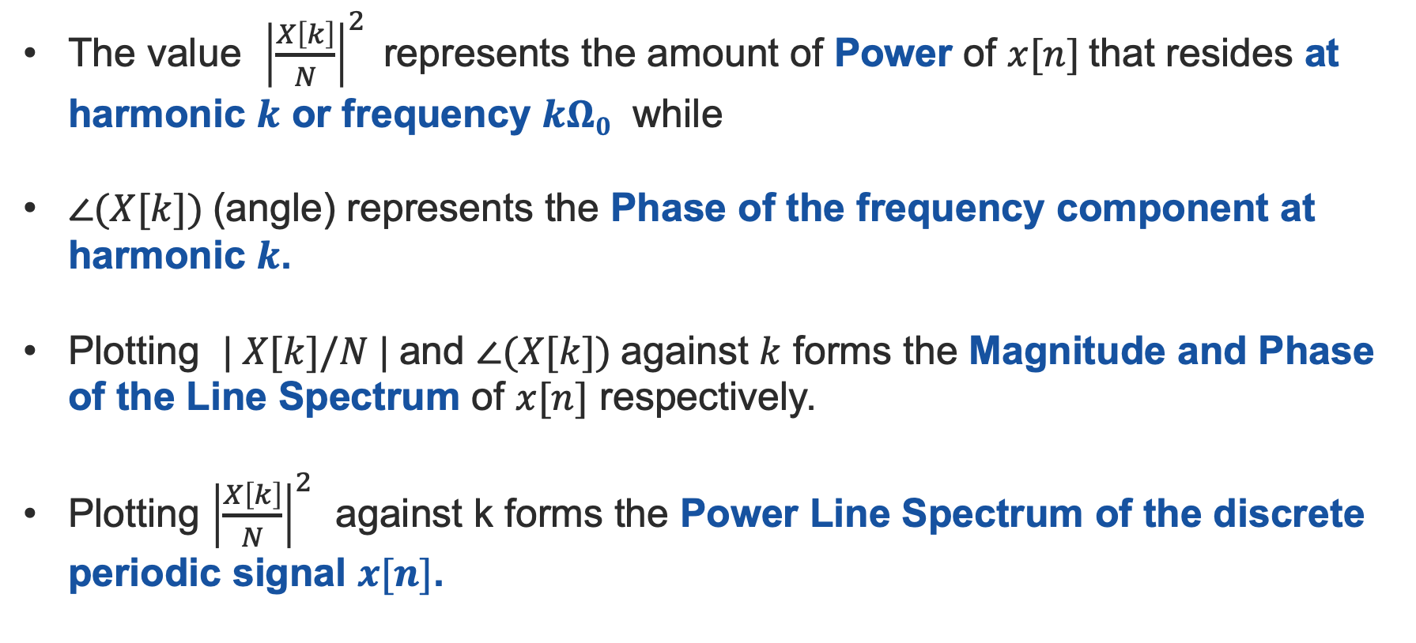
Line Spectra
The value ${\left|\frac{X\left[k\right]}{N}\right|}^{2}$represents the amount of Power of $x[n]$that resides at harmonic $k$ or frequency $kΩ0$ while
$∠(X[k])$(angle) represents the Phase of the frequency component at harmonic $k$.
Plotting $| X[k]/N |$and $∠(X[k])$against $k$ forms the Magnitude and Phase of the Line Spectrum of $x[n]$ respectively.
Plotting ${\left|\frac{X\left[k\right]}{N}\right|}^{2}$ against k forms the Power Line Spectrum of the discrete periodic signal $x[n]$.

Slide 9
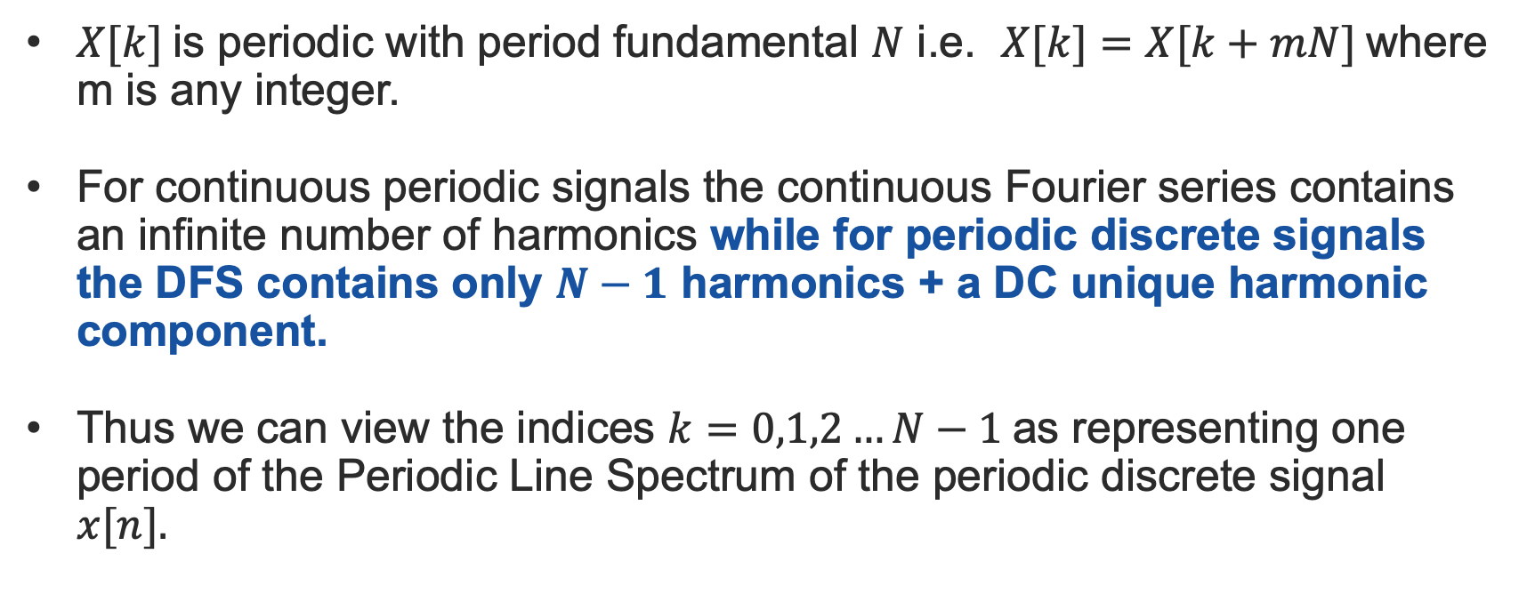
Negative Frequencies
$X[k]$is periodic with period fundamental $N$ i.e. $X[k]=X[k+mN]$where m is any integer.
For continuous periodic signals the continuous Fourier series contains an infinite number of harmonics while for periodic discrete signals the DFS contains only $N−1$ harmonics + a DC unique harmonic component.
Thus we can view the indices $k=0,1,2…N−1$as representing one period of the Periodic Line Spectrum of the periodic discrete signal $x[n].$

Slide 10
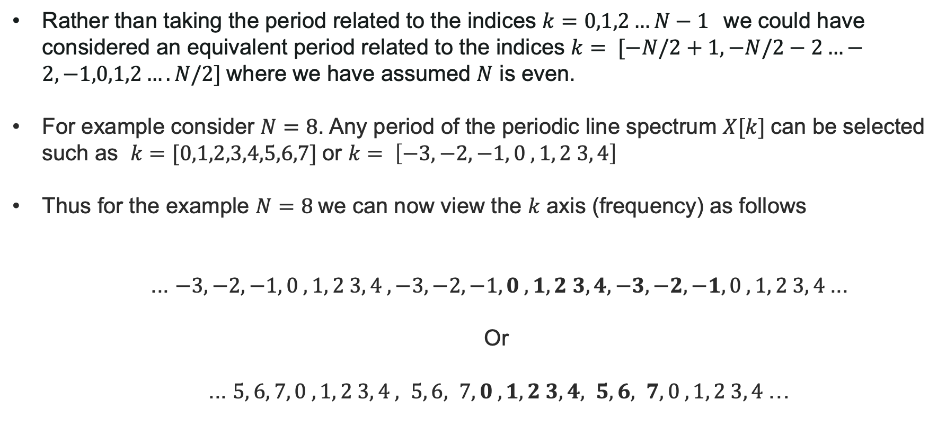
Negative Frequencies
Rather than taking the period related to the indices $k=0,1,2…N−1$we could have considered an equivalent period related to the indices $k= [−N/2+1, −N/2−2…−2,−1,0,1,2….N/2]$where we have assumed $N$ is even.
For example consider $N=8$. Any period of the periodic line spectrum $X[k]$can be selected such as $k=[0,1,2,3,4,5,6,7]$or $k= \left[−3,−2,−1, 0 , 1, 2 3, 4\right]$
Thus for the example $N=8$we can now view the $k$ axis (frequency) as follows
... $−3,−2,−1, 0 , 1, 2 3, 4 , −3,−2,−1, 0 , 1, 2 3, 4, −3,−2,−1, 0 , 1, 2 3, 4$...
Or
... $5, 6, 7, 0 , 1, 2 3, 4 , 5, 6, 7, 0 , 1, 2 3, 4, 5, 6, 7, 0 , 1, 2 3, 4$…

Slide 11
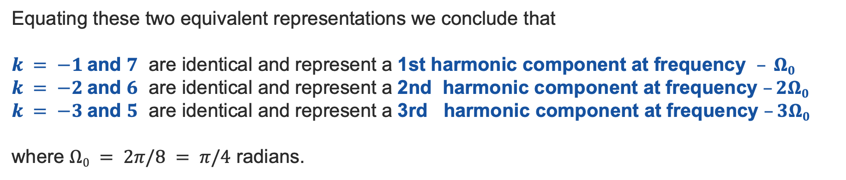
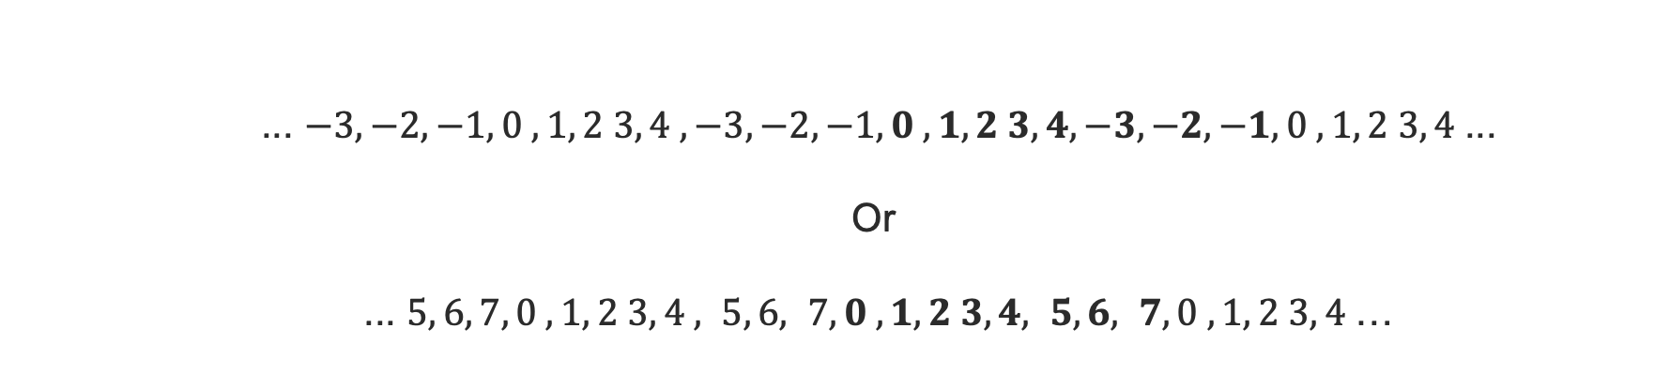
Negative Frequencies
... $−3,−2,−1, 0 , 1, 2 3, 4 , −3,−2,−1, 0 , 1, 2 3, 4, −3,−2,−1, 0 , 1, 2 3, 4$...
Or
... $5, 6, 7, 0 , 1, 2 3, 4 , 5, 6, 7, 0 , 1, 2 3, 4, 5, 6, 7, 0 , 1, 2 3, 4$…
Equating these two equivalent representations we conclude that
$k = −1$and $7$ are identical and represent a 1st harmonic component at frequency $– Ω0$
$k = −2$and $6$ are identical and represent a 2nd harmonic component at frequency $–2Ω0$
$k = −3$and $5$ are identical and represent a 3rd harmonic component at frequency $–3Ω0$
where $Ω0 = 2π/8 = π/4$ radians.

Slide 12
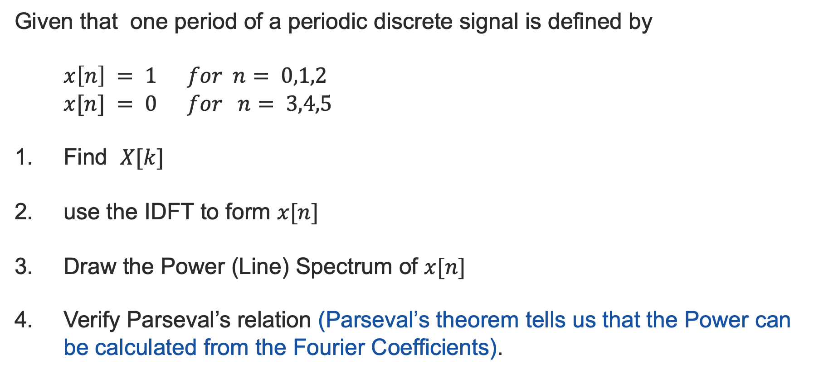
Example
Given that one period of a periodic discrete signal is defined by
$$x\left[n\right] = 1 for n= 0,1,2 \\ x[n] = 0 for n= 3,4,5$$
Find $X[k]$
use the IDFT to form $x[n]$
Draw the Power (Line) Spectrum of $x[n]$
Verify Parseval’s relation (Parseval’s theorem tells us that the Power can be calculated from the Fourier Coefficients).

Slide 13
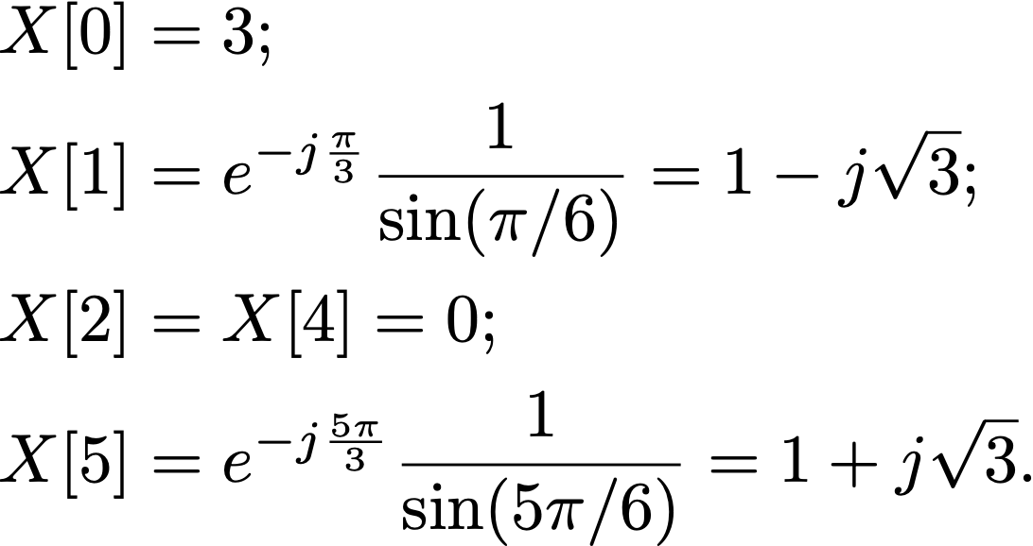
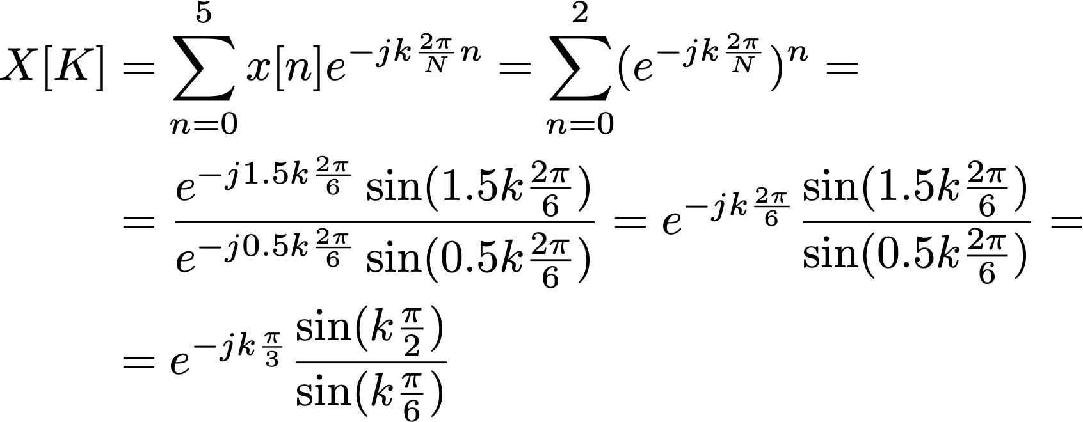
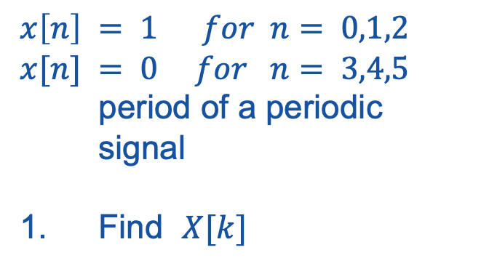

Example
$$x\left[n\right] = 1 for n= 0,1,2$$ $x[n] = 0 for n= 3,4,5$ period of a periodic signal
Find $X[k]$
$$X[3] = 1;$$

Slide 14

Example
2. Use the IDFT to form $x[n]$

Slide 15

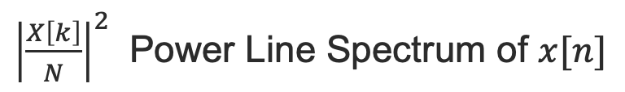



Example
3. Draw the Power (Line) Spectrum of $x[n]$
${\left|\frac{X\left[k\right]}{N}\right|}^{2}$ Power Line Spectrum of $x[n]$
$$X[3] = 1;$$
$${\left|\frac{X\left[k\right]}{N}\right|}^{2}$$
9/36
4/36
4/36
1/36
0 1 2 3 4 5
$$n$$

Slide 16
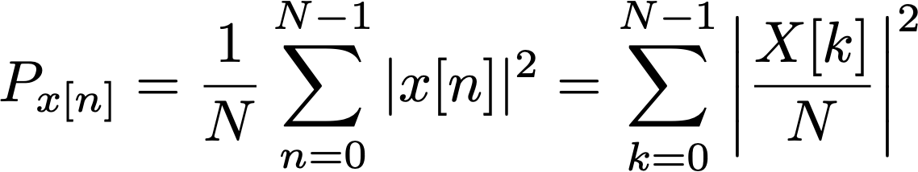
Example
4. Verify Parseval’s Relation
Parseval’s relation allows us to compute the power of x[n] from its power line spectrum, so the following relationship holds:

Slide 17
Exercise
A 50Hz sine waveform is sampled at four times the Nyquist sampling frequency. During the acquisition process the amplitude of the sine wave is clipped to ±0.7071 resulting in a distorted sine wave.
(i) Write down the values of one period of the acquired and sampled clipped sinusoid.
(ii) Make a plot of the underlying sinusoidal signal and the distorted sinusoid on the same plot
(iii) Using the DFS of the discrete clipped signal, determine the Total Harmonic Distortion (THD) i.e. the % power in the TOTAL harmonics (not including the 1st harmonic) compared to that in the fundamental harmonic (the 1st harmonic). THD is an important aspect in audio, communications and power systems and should normally be as low as possible. Sometime ‘music’ use THD for artistic reasons.

